Slide 1
PODCAST INTELLIGENCE DASHBOARD
AI-powered system that automatically transcribes podcast audio

Slide 2
Table of Contents
Project Overview & Objective
Methodology
Visualization
Approach
Model Architecture
Results
User Interface
Challenges & Limitations
Future scope
Conclusion

Slide 3
Project Overview:
Podcasts often span several hours, making it difficult to locate specific discussions or topics. This system solves that problem by: Converting audio into accurate text transcripts. Structuring transcripts into smaller semantic segments. Extracting representative keywords for each segment. Generating initial summaries for quick understanding.
Objective:
Transcribe podcast audio using fast and accurate speech-to-text models. Preprocess and normalize audio for better transcription quality. Segment transcripts into manageable, topic-oriented chunks. Extract keywords for each segment to support topic discovery. Generate initial summaries to provide high-level context. Maintain a clean, modular, and extensible pipeline.

Slide 4
Methodology
Audio Ingestion and Preprocessing:
Users upload raw podcast audio files into the system.
Audio is normalized to ensure stable downstream processing.
Preprocessing operations include:
Silence removal, Noise reduction, Conversion to mono channel & Resampling to 16 kHz
Speech Transcription
Preprocessed audio is converted into log-Mel spectrograms. An encoder–decoder architecture predicts text tokens with proper punctuation. The output is a high-quality, detailed text transcript.
Topic Segmentation and Text Analysis
The transcript is segmented sequentially into non-overlapping, topic-based sections. Segmentation preserves the natural flow of the original audio. Each segment undergoes lightweight NLP analysis, including:
Keyword extraction using frequency-based filtering Sentiment analysis using TextBlob.
Visualization and User Interaction
Using Streamlit UI the Analysis results are presented through an interactive Streamlit dashboard.
This interface enables efficient content exploration without listening to the entire audio recording.

Slide 5
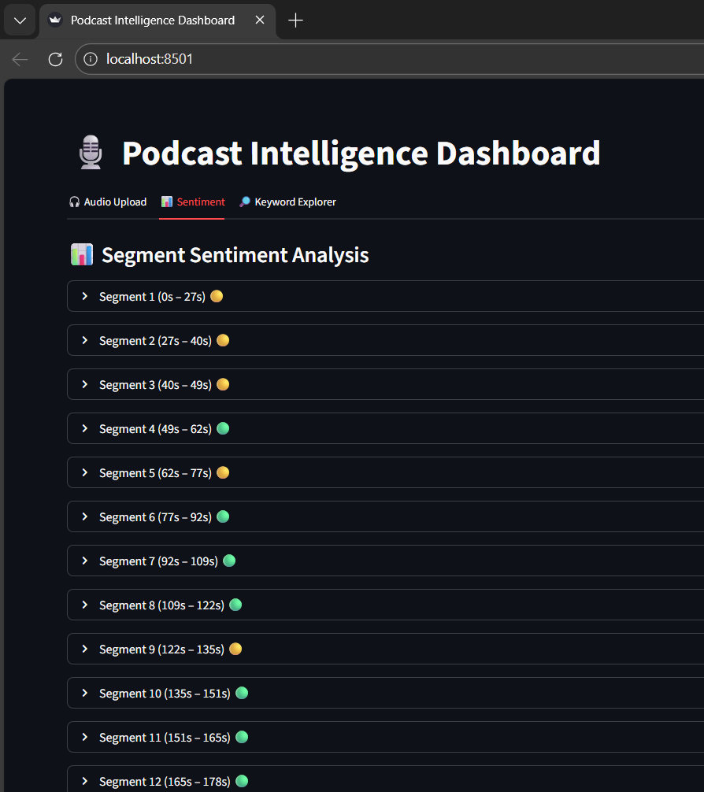
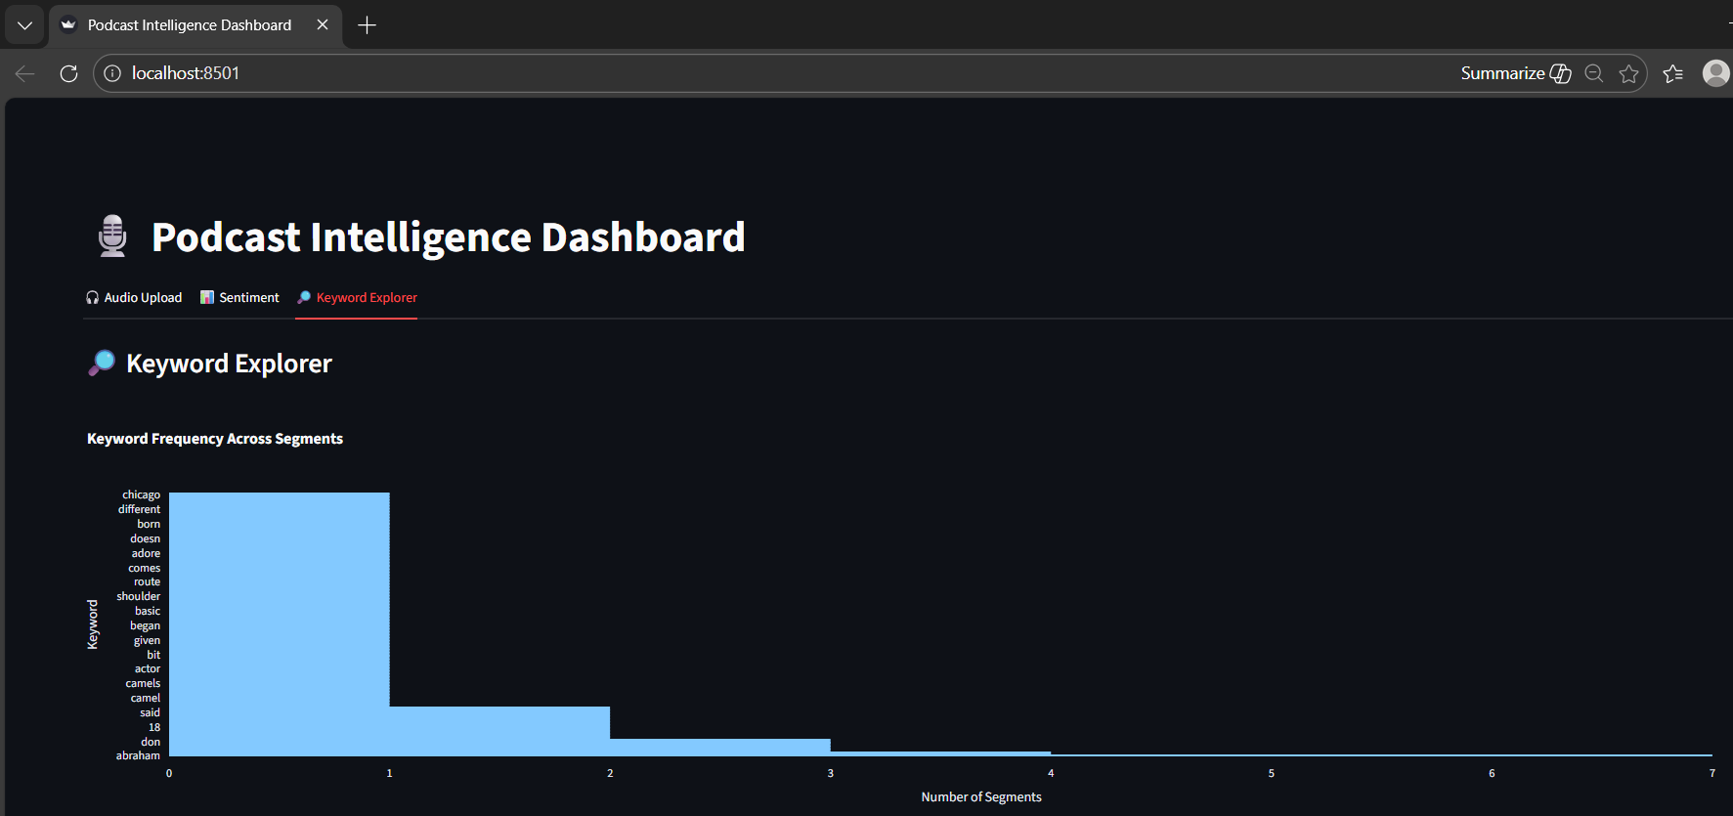
Visualization
Sentiment Analysis
Keywords in Segments

Slide 6
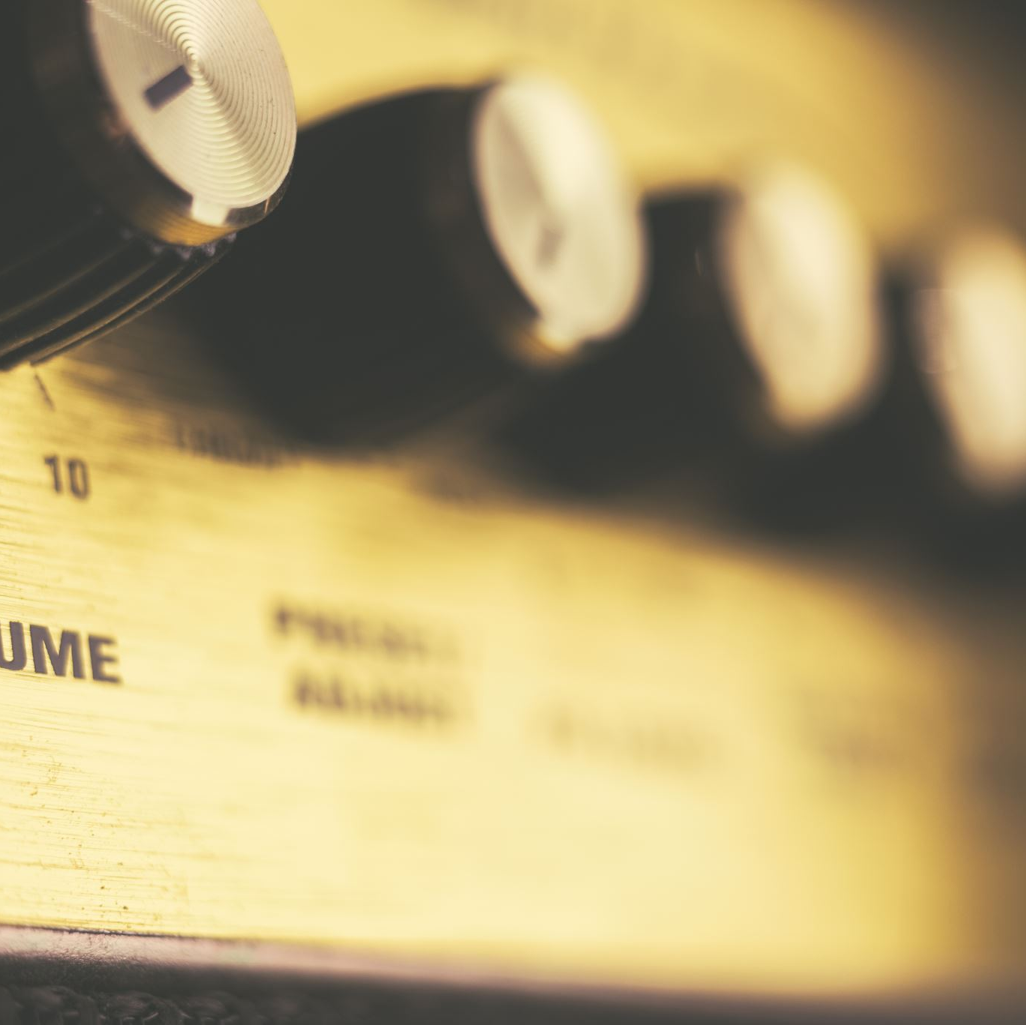




Approach
Audio Ingestion
Preparing raw audio for optimal transcription quality.
Speech Transcription
Converting spoken words into accurate, searchable text.
Topic Segmentation and Text Analysis
Structuring text into meaningful segments and extracting insights.
Sentiment Analysis
Sentiment analysis for each segment.
Visualization
Presenting insights through an intuitive and interactive interface.

Slide 7
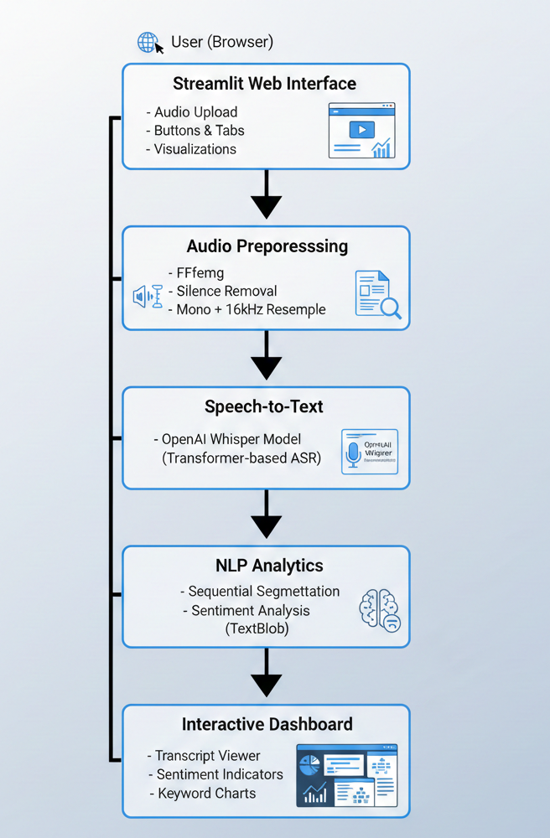
Model Architecture
The project follows a monolithic, pipeline-based architecture implemented using Streamlit, where both the user interface and backend processing are integrated within a single application. User-uploaded podcast audio is first preprocessed to remove silence and noise, converted to a mono channel, and resampled to 16 kHz to ensure compatibility with the transcription model. The cleaned audio is then passed to the OpenAI Whisper transformer-based speech-to-text model to generate an accurate transcript. This transcript is sequentially segmented into topic-based sections, followed by keyword extraction and sentiment analysis for each segment. All processed outputs, including transcripts, segments, sentiment indicators, and keyword visualizations, are presented through an interactive Streamlit dashboard, enabling efficient exploration of long-form audio content.

Slide 8
Results
1.Audio Preprocessing:
Converts raw podcast audio into a standard format
Removes background noise and silent segments
Ensures consistent audio quality
2. Speech-to-Text Transcription:
Converts podcast audio into text
Generates transcripts
3. Topic Segmentation:
Divides long transcripts into meaningful segments
Transcript is split into contiguous blocksEach segment covers a continuous time range.
No overlap between segments

Slide 9
4. Keyword Extraction
Keyword segmentation identifies the core themes of each transcript segment by extracting frequently occurring, meaningful words after removing common stop-words and duplicates.
It helps in summarizing topic content without generating full textual summaries, allowing users to quickly understand what each segment discusses.
Keyword segmentation enables efficient navigation and search,, user can locate relevant segments based on the keywords rather than reading entire script.
5. Sentiment & Quality Analysis
Sentiment analysis evaluates the emotional tone of each transcript segment using polarity scores to classify them as positive, neutral, or negative.
It provides a quick qualitative insight into how topics are discussed without requiring complex emotion models.
Visual sentiment indicators help users identify emotionally significant segments at a glance.
6. Frontend Visualization
The Streamlit-based interface allows users to upload audio files and trigger processing steps interactively.
Expandable segment views, keyword search, and visual indicators make it easy to explore long transcripts efficiently.
Integrated charts and visual components improve content readability and user engagement without overwhelming the user.

Slide 10
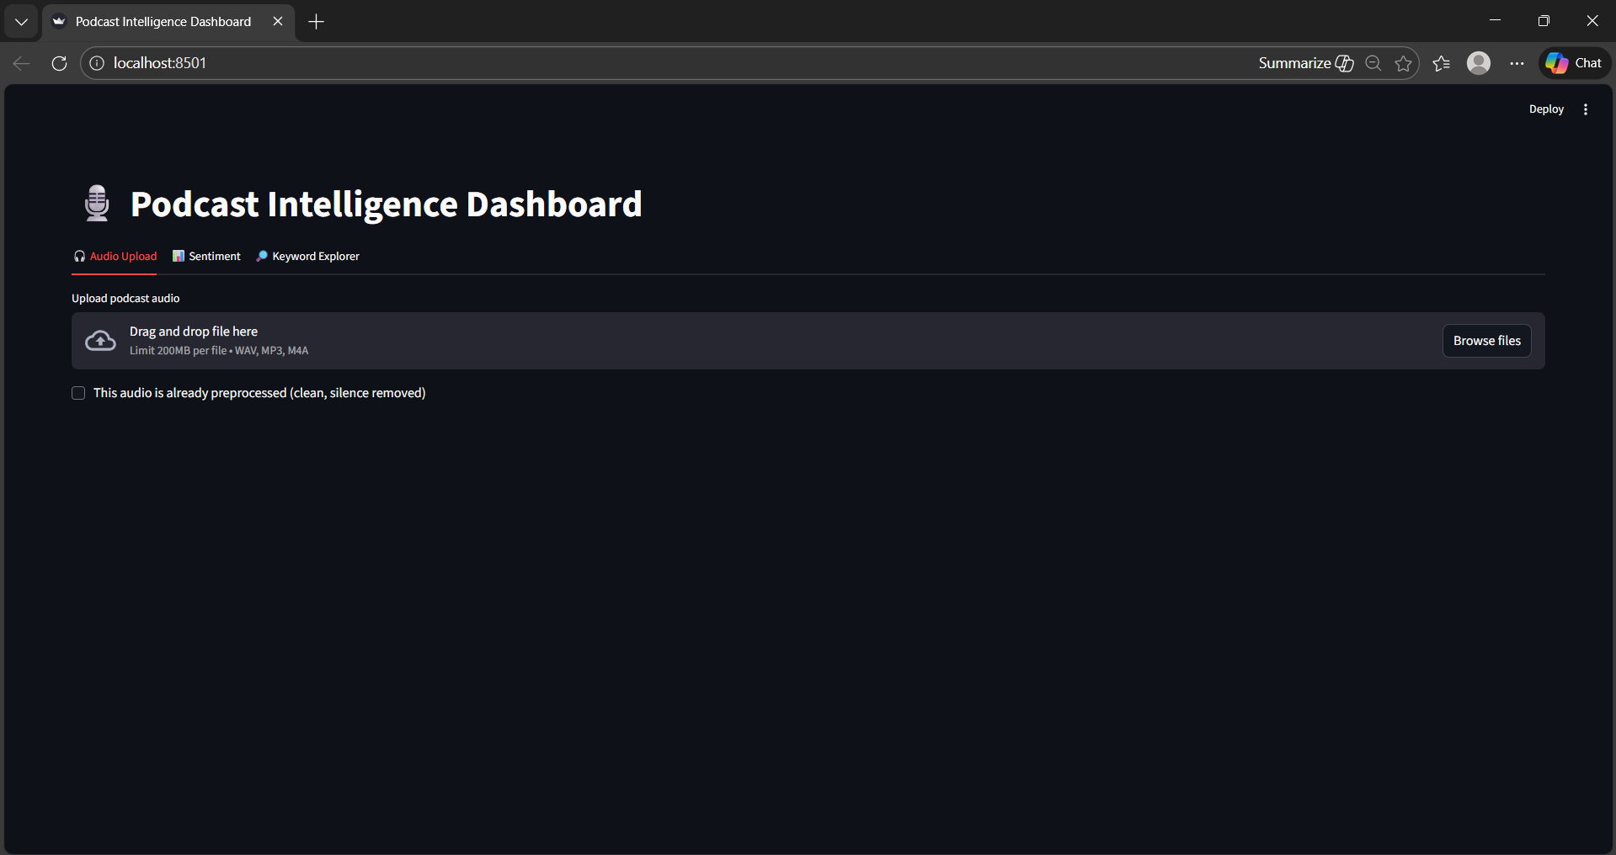
User Interface

Slide 11
Challenges & Limitations
Transcription accuracy depends heavily on audio quality; noisy or accented speech may reduce performance.
Large Whisper models require significant memory, which can be challenging on low-resource systems.
Topic segmentation is heuristic-based and may not always perfectly align with true conversational shifts.
Keyword extraction and summarization rely on statistical methods and may miss deeper semantic meaning.
The system is optimized for offline analysis of datasets like TED Talks, not large-scale real-time deployment.

Slide 12
Future Scope
Use faster transcription frameworks or GPU acceleration to reduce processing time for long audio files.
Add automatic summarization using large language models to generate concise episode or segment summaries.
Extend the system to support real-time or live audio transcription.
Improve topic segmentation using semantic similarity or transformer-based topic modeling techniques.
Deploy the application on cloud platforms to enable public and scalable access.

Slide 13
Automated audio podcast transcription and segmentation system provides a powerful solution for navigating and understanding lengthy audio content with unprecedented ease. By transforming spoken words into structured, analyzable data, users can quickly access specific information, grasp key topics, and derive valuable insights without the need for extensive listening. From its modular pipeline to its intuitive visualization, this project demonstrates a significant step forward in making rich audio content more accessible and manageable.
Conclusion

Slide 14
THANK YOU
Q&A

